Slide 1
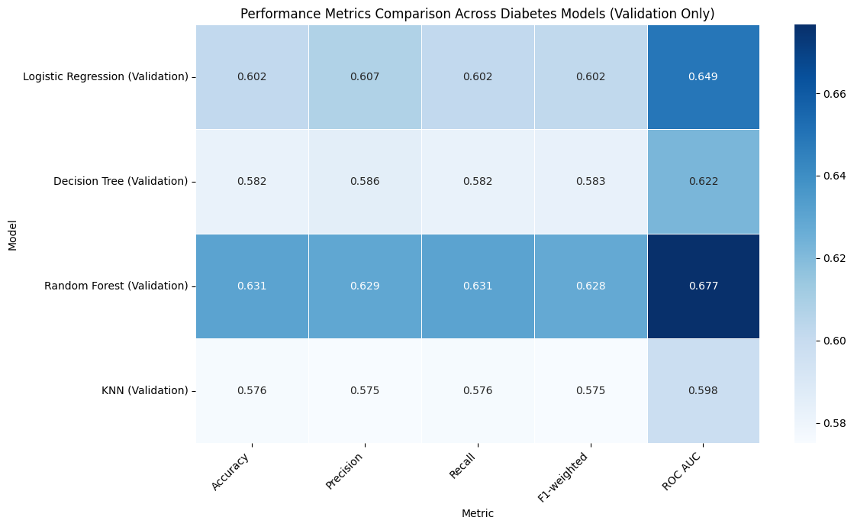
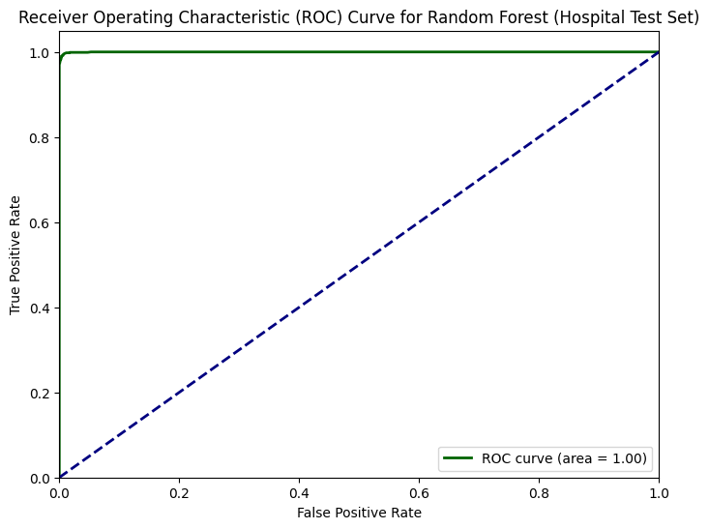
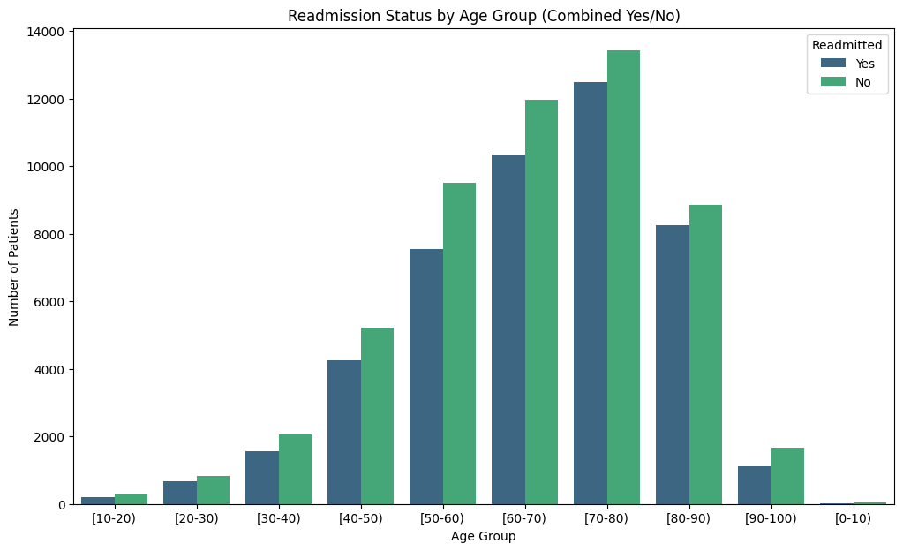
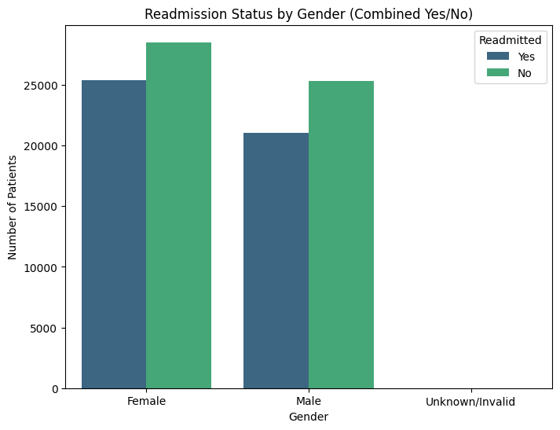
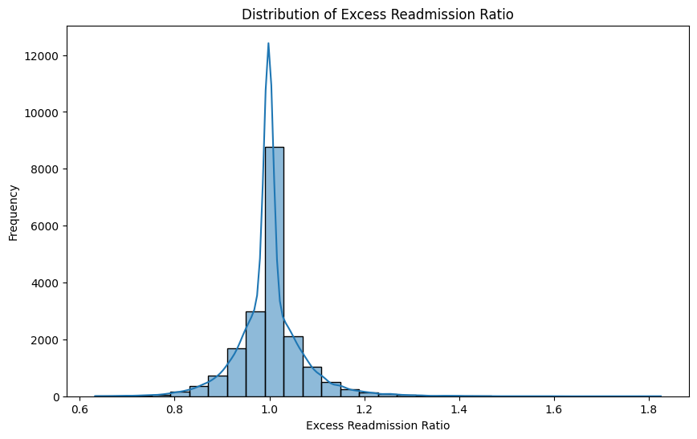
Diabetes Related Hospital Readmissions: A Predictive Approach
Author: Alex Nite
Introduction
Models
Models
Hospital readmissions for diabetes are costly and often preventable. Combining patient-level and hospital-level data helps identify high-risk patients and underperforming hospitals. This project analyzes both datasets to uncover patterns, model readmission risks, and guide targeted interventions.
Diabetes Dataset Models
/tmp/ipython-input-1101155210.py:6: UserWarning: This pattern is interpreted as a regular expression, and has match groups. To actually get the groups, use str.extract. (performance_df.index.str.contains('(Test)') == False)
Objective
Predict 30-day readmission for diabetes patients using patient-level data.
Identify hospitals features that lead to excess readmission rates.
Compare model performances to inform clinical and operational strategies.
Data Overview
Both datasets underwent preprocessing which included: handling missing values, basic feature engineering, removal of low-value columns, one-hot encoding, class-weighting for imbalance, normalization, and PCA (90 percent variance retained).
Diabetes Dataset
100, K+ patients (85K+ after stratified sampling for KNN specifically).
Target: binary readmission.
Hospital Dataset
Includes discharges, readmission rates, ICD and HCPCS codes, and state information.
Target: excess_readmission_flag.
Fig 1.3 Heat Map Comparison of Diabetes Data set Model
Hospital Dataset Model
Hospital Dataset Random Forest Performance Metric for Test Data
EDA Highlights
Metric | Precision | Recall | F1-Score
Class 0 | 0.99 | 1 | 0.99
Class 1 | 0.99 | 0.99 | 0.99
Accuracy | - | 0.99 | -
Diabetes Dataset
Table 2.1
Fig 2.2 ROC curve for Hospital Dataset Test data
Fig 1.1
Age is a strong predictor of diabetes risk
Fig 1.2
Female represent the larger share of the overall patient group.
Findings & Synthesis
Hospital Dataset
For patient-level diabetes data, age, prior hospital visits, and medication changes are key drivers of readmission risk. High-risk patients can be identified for targeted care interventions.
For hospital-level data, the model shows that excess readmissions are largely determined by the hospital’s own readmission metrics, shifting the focus from prediction to understanding operational drivers like care coordination, discharge planning, and post-discharge support.
Overall, combining patient and hospital data provides a holistic view, linking individual risk factors with institutional performance to guide targeted interventions, resource allocation, and policy actions.
Fig 2.1
Most hospitals cluster around a ratio of 1.0, with a slight right skew showing many just above 1.0 (higher-than-expected readmissions). Fewer hospitals fall below 1.0, indicating lower-than-expected readmissions.
Recommendations
High-Risk Patients: Target follow-up, home care, and education for patients with complex conditions or multiple prior visits.
Hospital Processes: Improve care coordination, discharge planning, and post-discharge support.
Resource Allocation: Focus staff and programs where readmissions are most likely.
Policy Guidance: Promote standardized protocols and equitable access to follow-up care.

